Slide 1
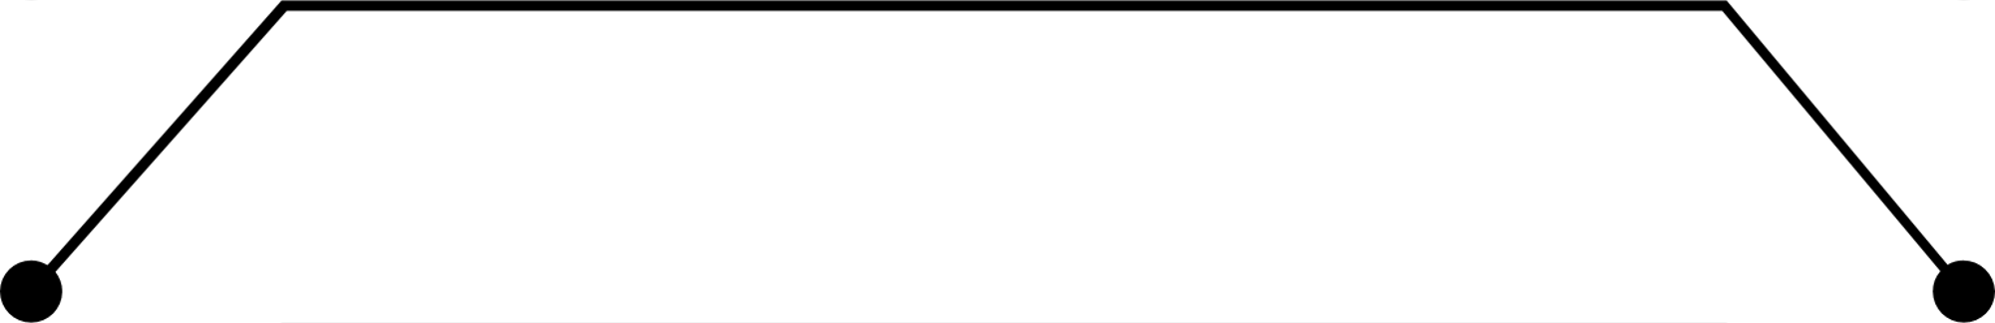
IIT ROORKEE
LAB-BASED PROJECT
iReplica
A counterfeit Product Detection System

Slide 2
SUPERVISORS
PROF. PRADUMN KUMAR PANDEY
TEAM
RAHUL KURKURE - 20114079
DHERAVATH VIKAS - 20114033
KUDIKALA RISHIKESH - 20114066

Slide 3
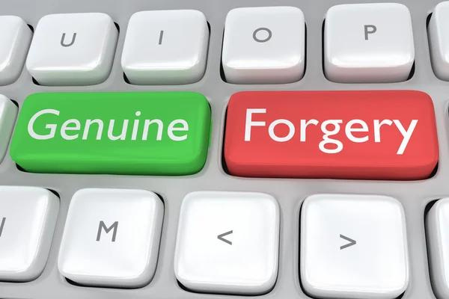
Probem Statement
PRODUCT COUNTERFIETING
Counterfeit products pose a significant threat to the global economy and consumer safety, with losses estimated to be in the trillions of dollars annually. Current methods for detecting counterfeit products are often unreliable, leading to a need for innovative and effective solutions to address this problem

Slide 4
Motivation
Counterfeit products can result in significant financial losses for both businesses and consumers, leading to a need for innovative solutions to address this problem.
The proposed blockchain-based mechanism utilizing the ERC ownership mechanism aims to provide a more reliable and secure method of product authentication, thereby reducing the impact of counterfeit products on the global economy and consumer safety

Slide 5

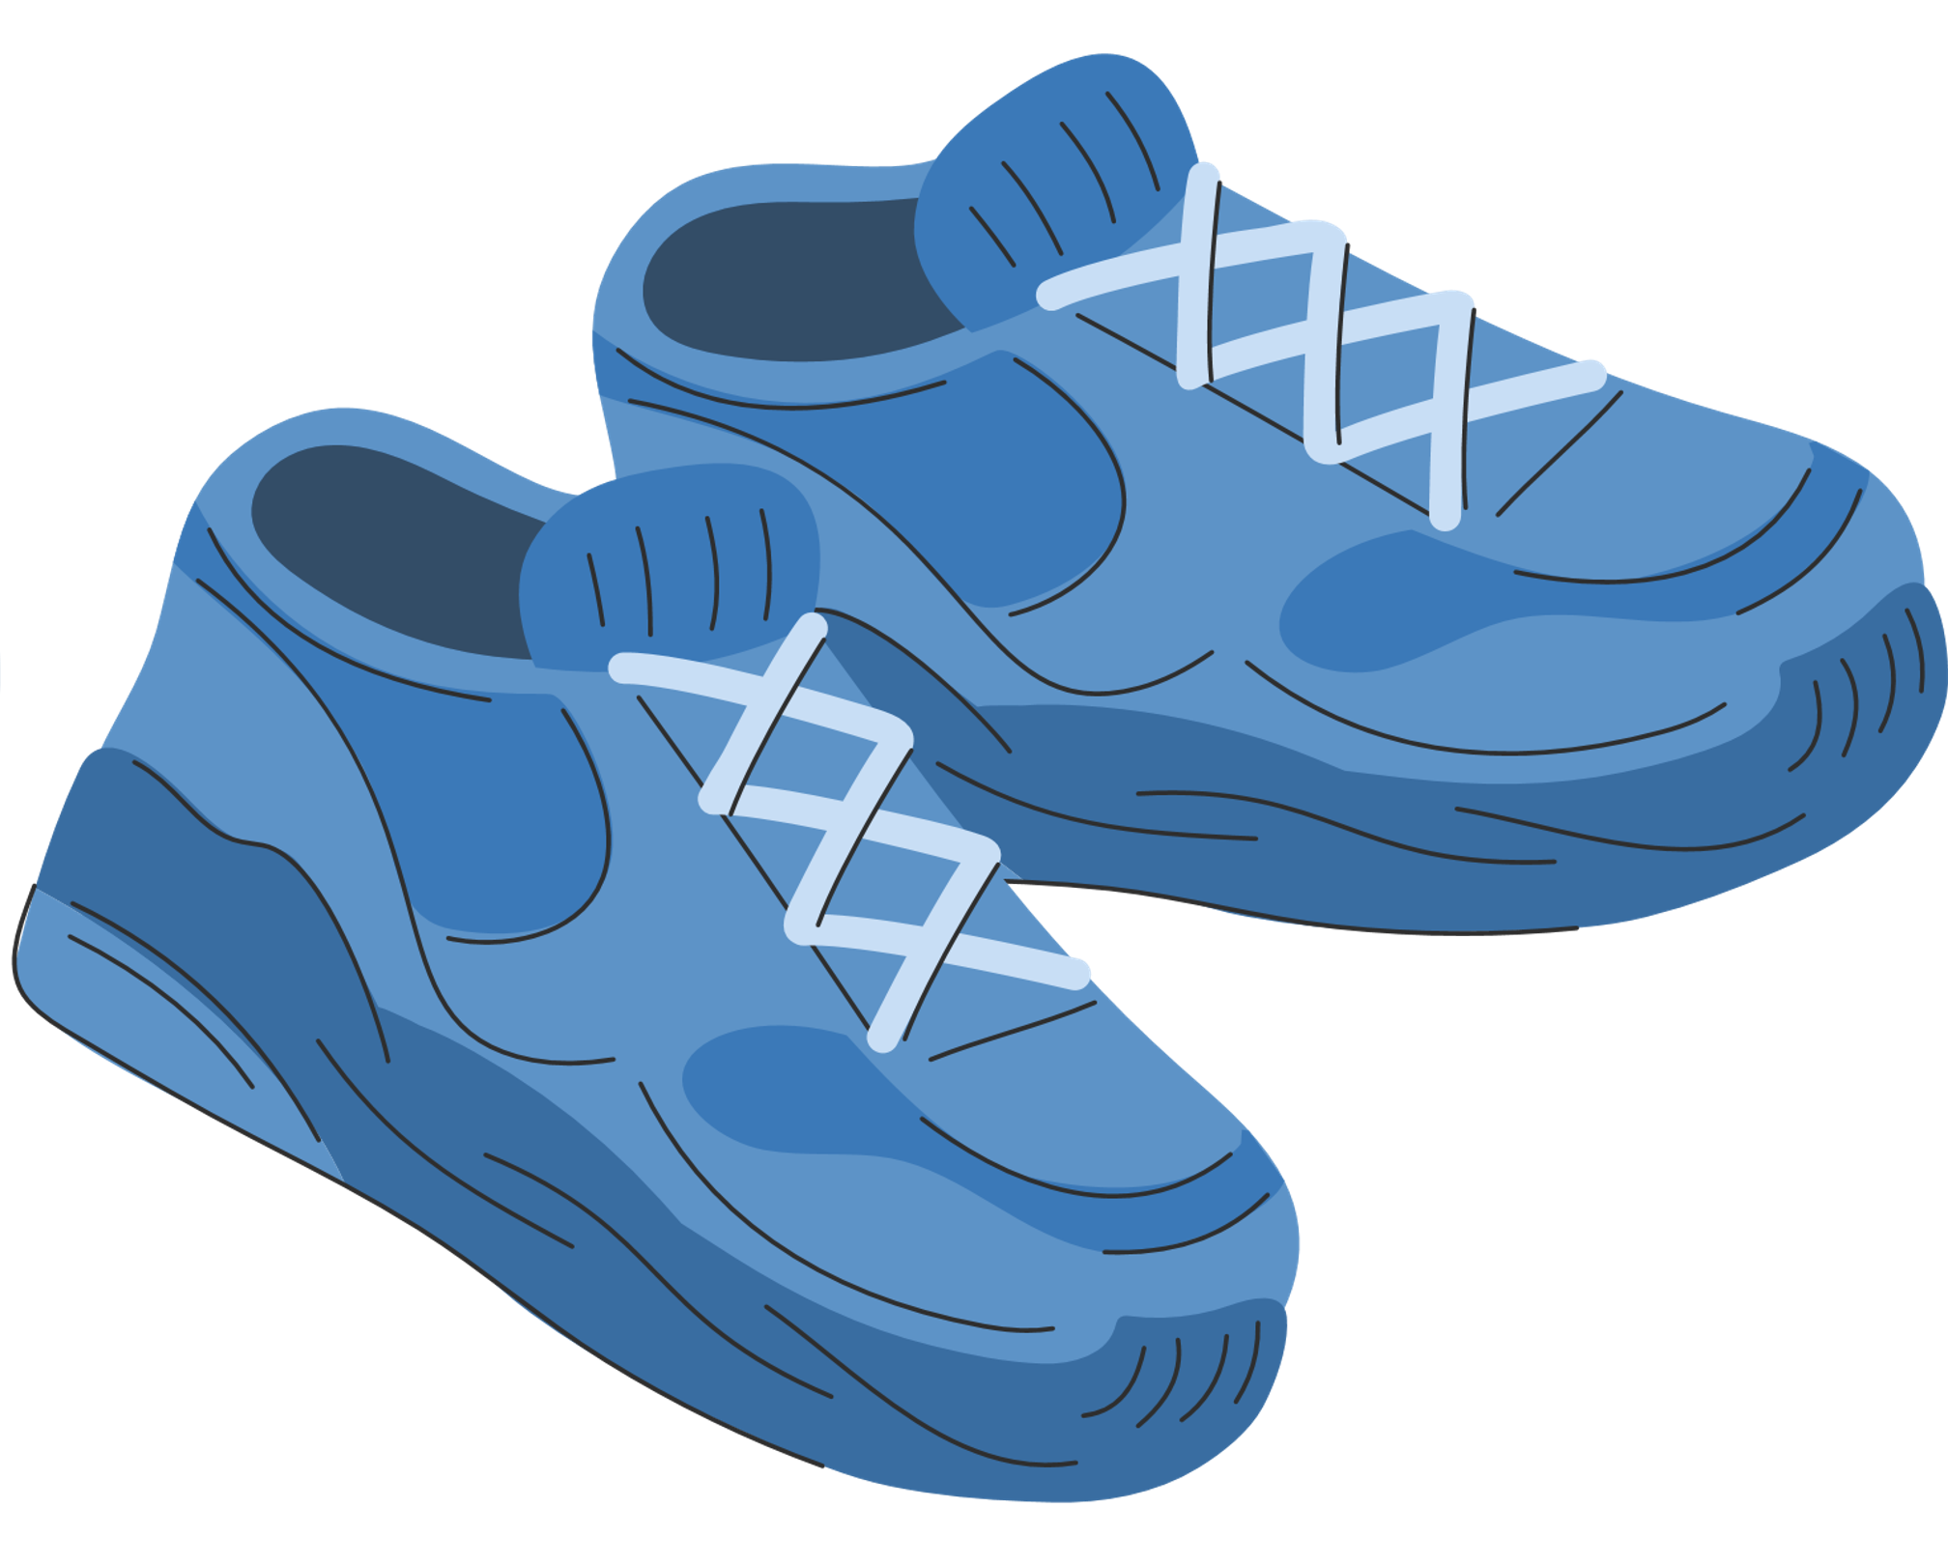

Problem Statement
Sam want to buy shoes from brand Adidas

Slide 6
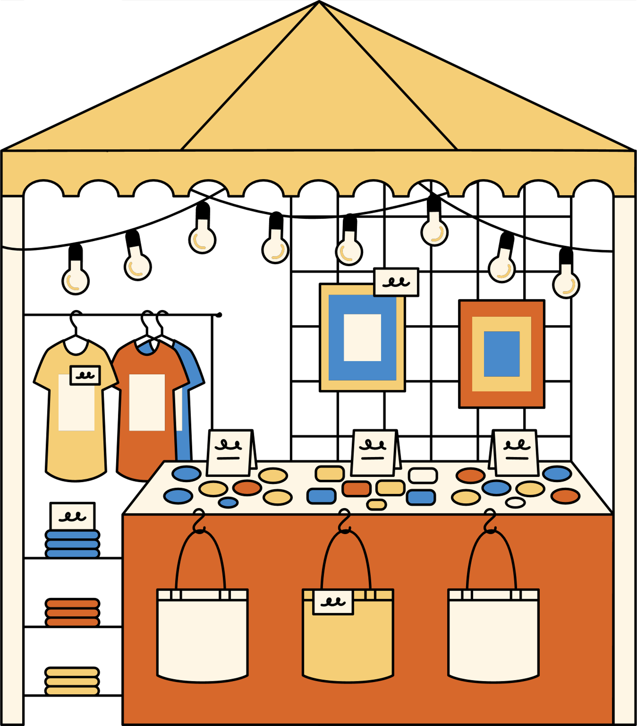
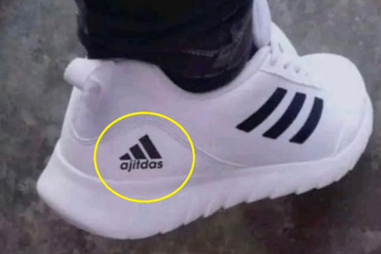

Problem Statement
There a too many shoes which look exactly the same. But how their prices varies soo much ?
How the Quality of the product varies soo much ?
Now its getting difficult to buy the real ones..

Slide 7


Problem Statement
This seems so real, and the price also seems fair enough.
These shoes must be genuine.
lets buy them

Slide 8
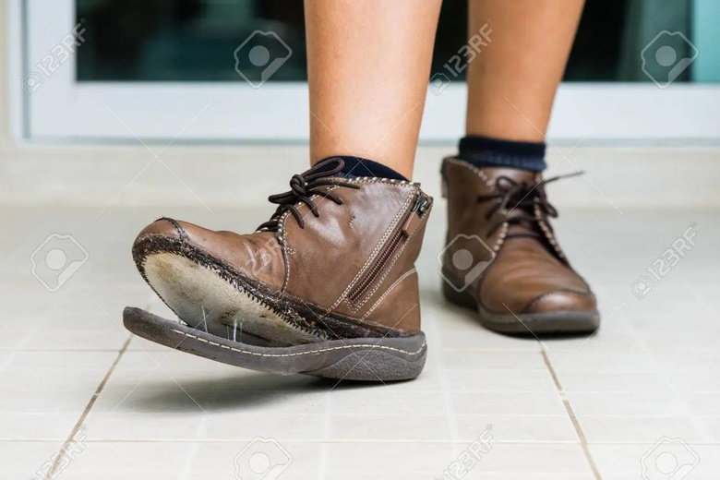

Problem Statement
Oh no I got Scammed

Slide 9


Problem Statement
why people are not buying our products ?

Slide 10

Blockchain
Decentralized
Immutable ledger
Smart Contracts
ERC 721

Slide 11
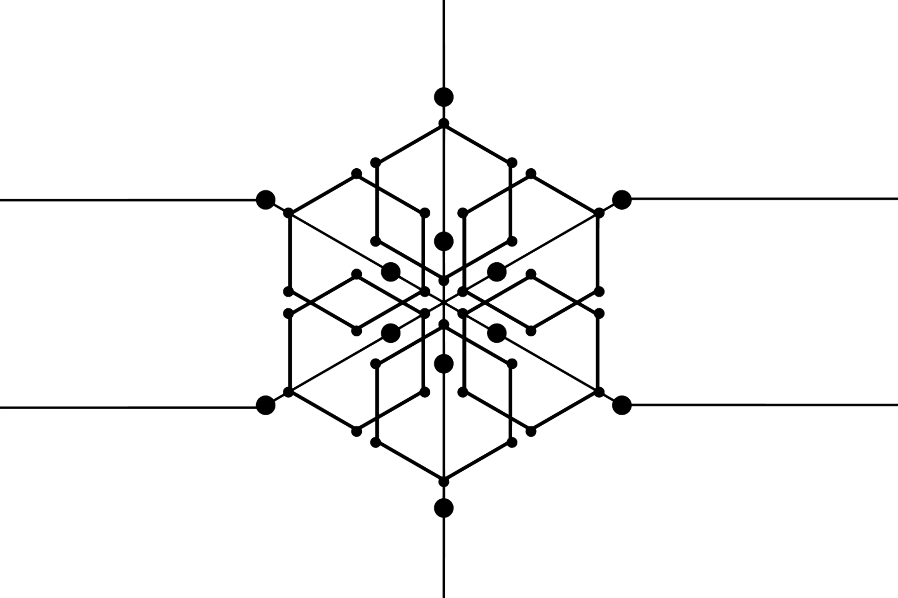

Proposed Solution
BLOCKCHAIN BASED OWNERSHIP
A blockchain-based fake product detection mechanism utilizing the ERC ownership mechanism is proposed as a solution to the problem of counterfeit products.
By implementing this mechanism, manufacturers and consumers can have greater confidence in the authenticity of their products and prevent the sale of counterfeit goods

Slide 12


Algorithm
METAMASK WALLET
MetaMask allows users to store and manage account keys, broadcast transactions, send and receive Ethereum-based cryptocurrencies and tokens, and securely connect to decentralized applications through a compatible web browser or the mobile app's built-in browser.

Slide 13
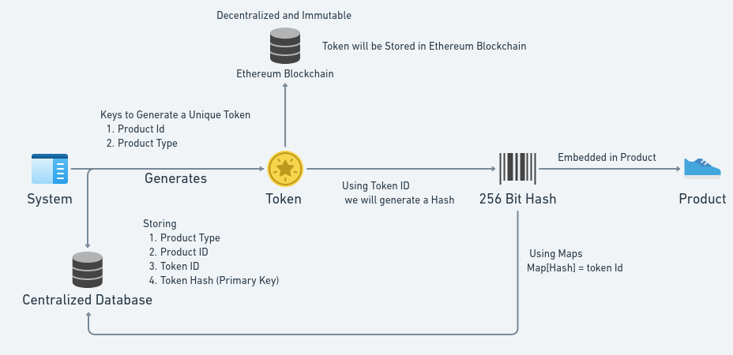
Algorithm

Slide 14
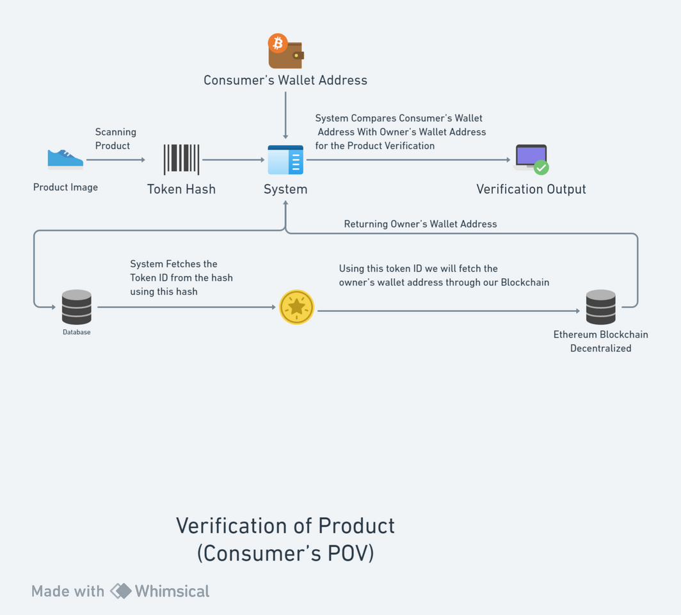
Algorithm

Slide 15
Algorithm
Node.js is being used to develop the backend of the system
MongoCloud is being used as a database to store product info and mapped hashcodes.
Solidity is being used to develop the smart contracts
Currently Sepolia faucet is being used as testnet for development
React.js is being used for developing the frontend of the product.

Slide 16
Future works
There can be many possibilities depending on the exploration of new counterfeiting methods. And Additionally we can provide further features which ensure a some special case like online payments etc. or Supply Chain management.
Product Ownership Transfer Mechanism for Online transactions.
History of Owners Feature

Slide 17
Potential Exploits:
There's three main ways to potentially exploit our system:
1. Seller generated hash.
2. Copy of a genuine hash.
3. Seller is the one selling the counterfeits.

Slide 18
CONCLUSION

Slide 19
Limitations:
Customer sentiment towards Crypto wallets such as Metamask.
Scaling iReplica further.

Slide 20
Future works
There can be many possibilities depending on the exploration of new counterfeiting methods. And Additionally we can provide further features which ensure a some special case like online payments etc. or Supply Chain management.
Product Ownership Transfer Mechanism for Online transactions.
History of Owners Feature

Slide 21
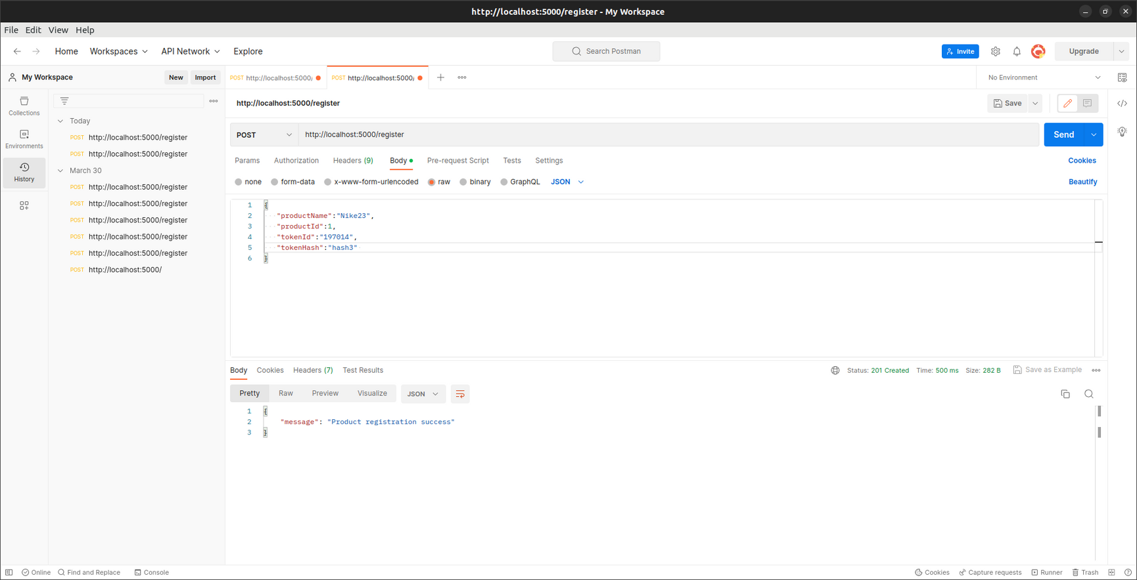
Progress so far
The Basic CRUD API for Registration of product

Slide 22
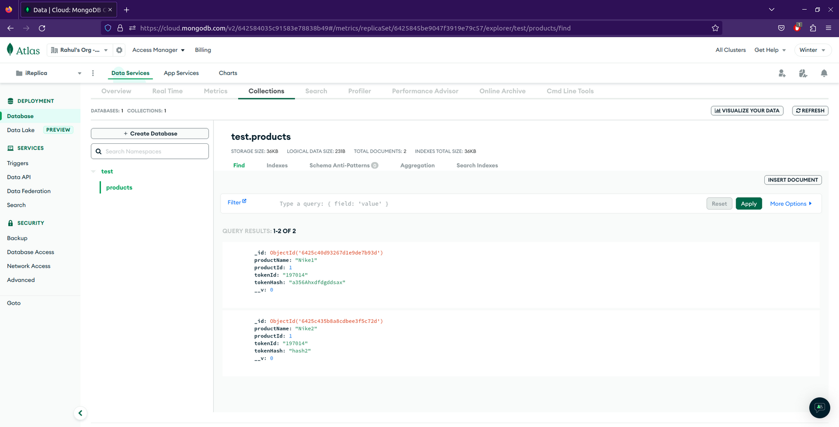
Progress so far
The Database

Slide 23
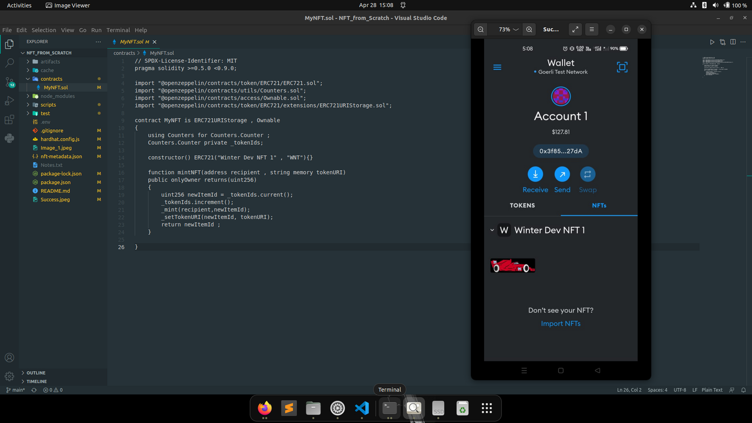
Progress so far
Solidity Smart Contract

Slide 24
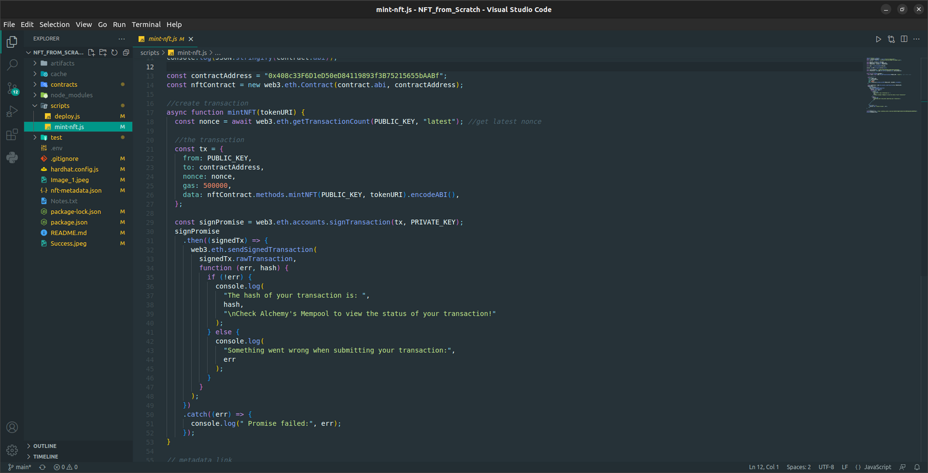
Progress so far
Smart Contract Deployment

Slide 25
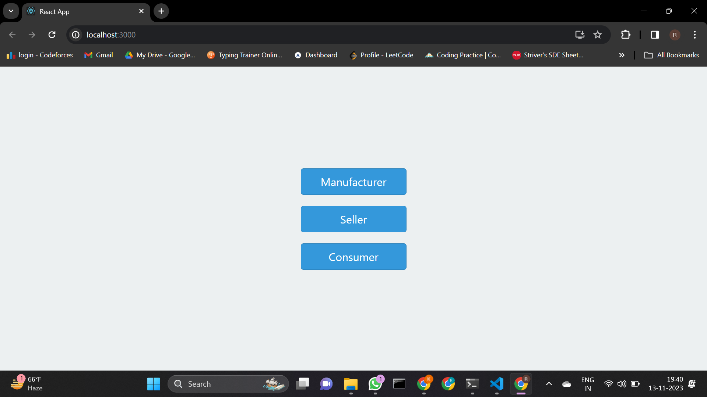
Progress so far​

Slide 26
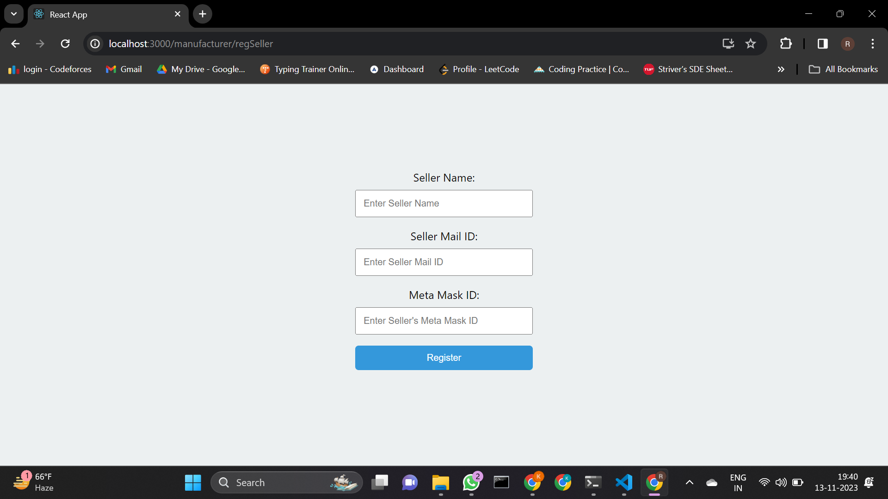
Progress so far

Slide 27
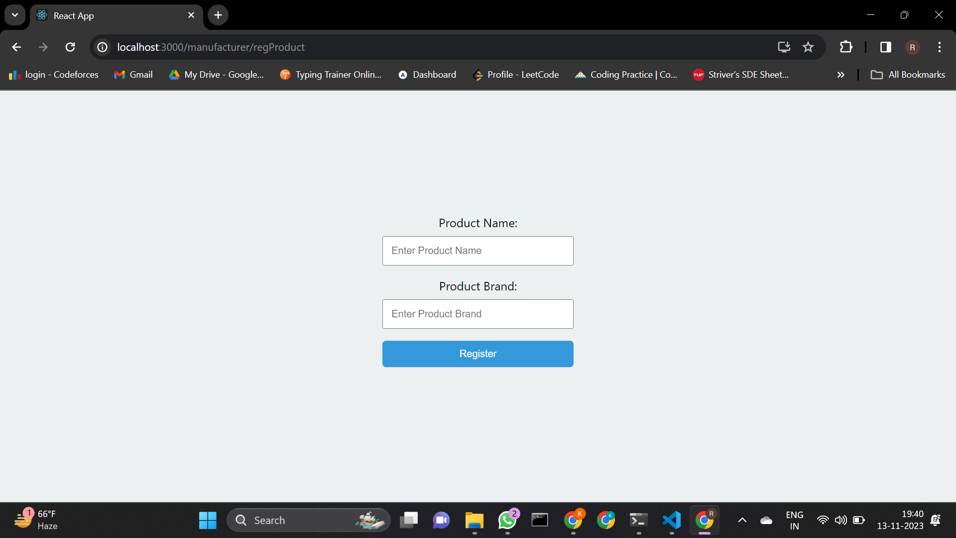
Progress so far

Slide 28
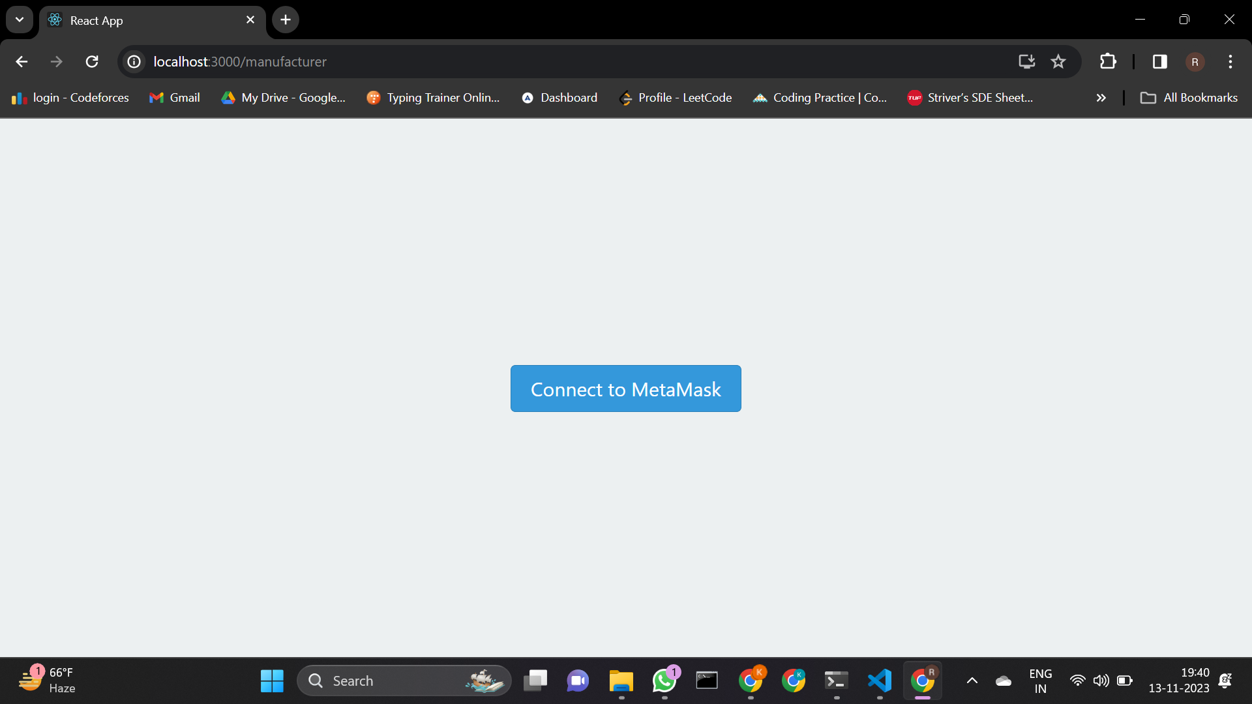
Progress so far​

Slide 29
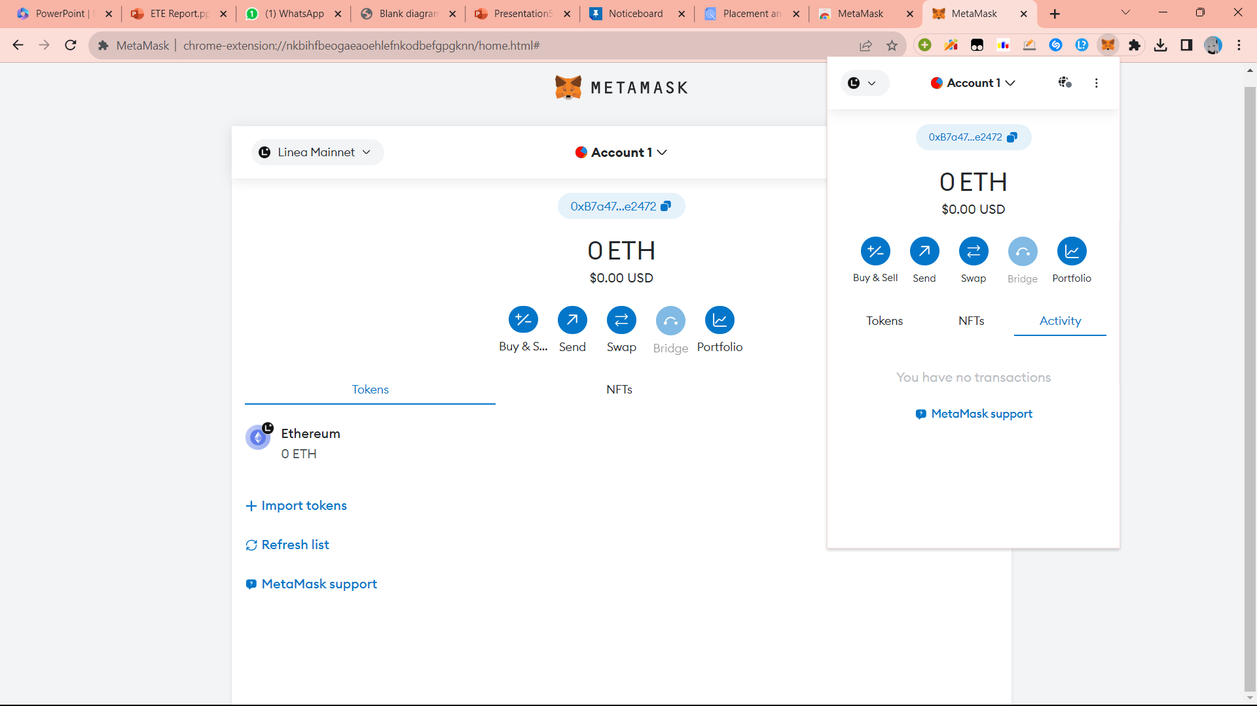
Progress so far​

Slide 30
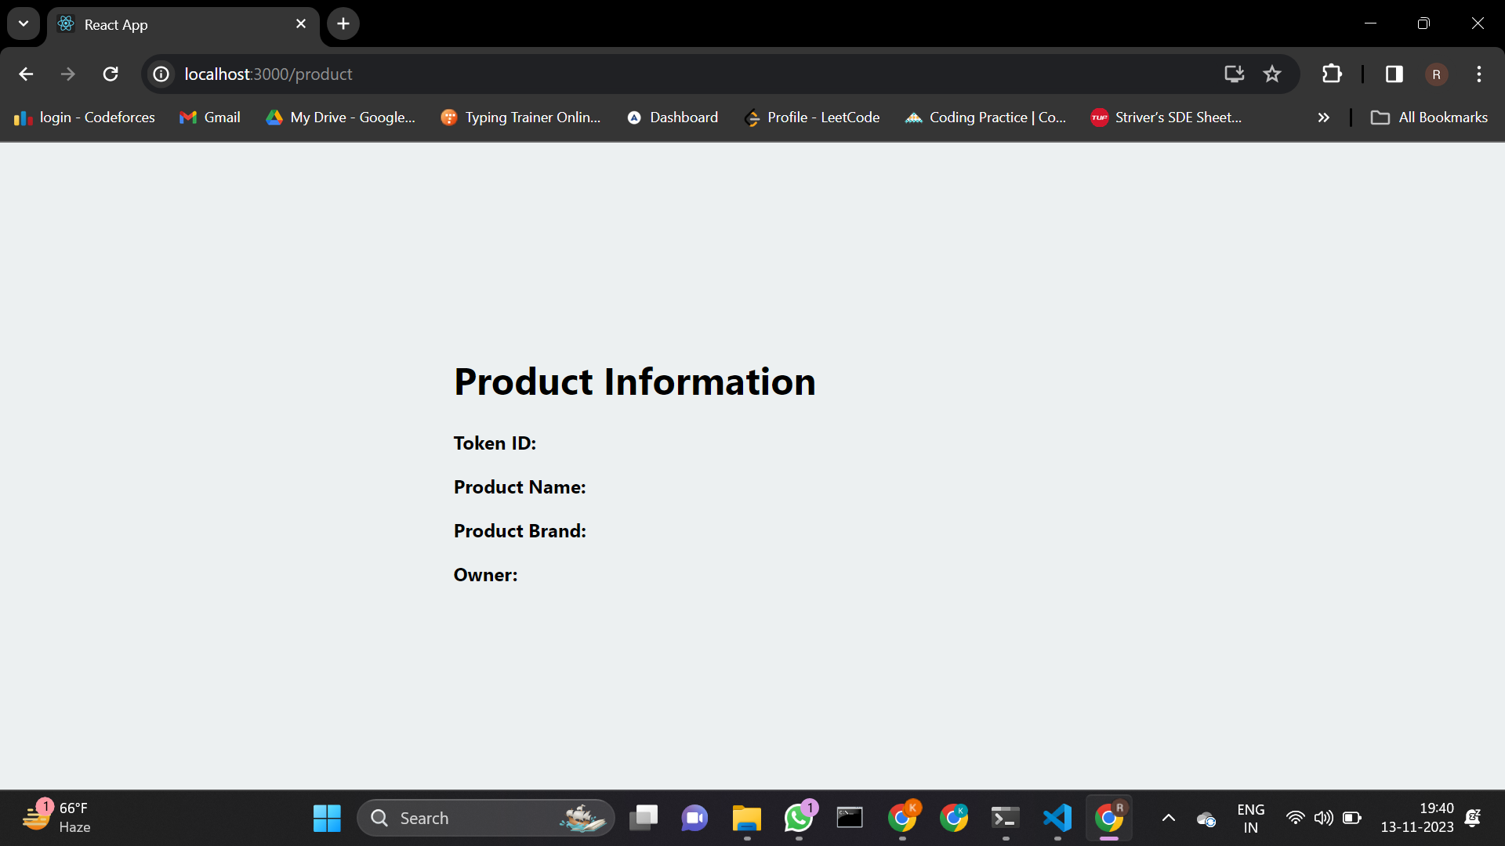
Progress so far

Slide 31
References
[1] Bauer, D. P. (2022). ERC-721 Nonfungible Tokens. In Getting Started with Ethereum: A Step-by-Step Guide to Becoming a
Blockchain Developer (pp. 55-74). Berkeley, CA: Apress.
[2] Lavanya, P. M., Ananthi, N., Kumaran, K., Abinaya, M., Kalaivani, B., Krithika, V., & Rahul, S. S. (2021, December). Fake
Product Detection using Blockchain. In 2021 4th International Conference on Computing and Communications Technologies
(ICCCT) (pp. 133-137). IEEE.
[3] Ma, J., Lin, S. Y., Chen, X., Sun, H. M., Chen, Y. C., & Wang, H. (2020). A blockchain-based application system for product
anti-counterfeiting. IEEE Access, 8, 77642-77652.
[4] Bauer, D. P. (2022). ERC-721 Nonfungible Tokens. In Getting Started with Ethereum: A Step-by-Step Guide to Becoming a
Blockchain Developer (pp. 55-74). Berkeley, CA: Apress.
[5] Krombholz, K., Frühwirt, P., Kieseberg, P., Kapsalis, I., Huber, M., & Weippl, E. (2014). QR code security: A survey of attacks and
challenges for usable security. In Human Aspects of Information Security, Privacy, and Trust: Second International Conference,
HAS 2014, Held as Part of HCI International 2014, Heraklion, Crete, Greece, June 22-27, 2014. Proceedings 2 (pp. 79-90).
Springer International Publishing.

Slide 32
References
6] Syed, T. A., Alzahrani, A., Jan, S., Siddiqui, M. S., Nadeem, A., & Alghamdi, T. (2019). A comparative analysis of blockchain
architecture and its applications: Problems and recommendations. IEEE access, 7, 176838-176869.
[7] Cachin, C. (2016, July). Architecture of the hyperledger blockchain fabric. In Workshop on distributed cryptocurrencies and
consensus ledgers (Vol. 310, No. 4, pp. 1-4).
[8] Truica, C. O., Radulescu, F., Boicea, A., & Bucur, I. (2015, May). Performance evaluation for CRUD operations in asynchronously
replicated document oriented database. In 2015 20th International Conference on Control Systems and Computer Science (pp.
191-196). IEEE.
[9] Koirala, R. C., Dahal, K., & Matalonga, S. (2019, January). Supply chain using smart contract: a blockchain enabled model with
traceability and ownership management. In 2019 9th International Conference on Cloud Computing, Data Science &
Engineering (Confluence) (pp. 538-544). IEEE.

